Slide 1
Forecasting
Supply Chain Management, Chapter 7
Christopher J Chen
Department of Operations and Decision Technologies

Slide 2
Outline
Introduction
Time-series forecasting
Static forecasting
Adaptive forecasting
Estimating the level, trend and seasonal factors
Spreadsheet application
Using StatTools for linear regression
Using StatTools for adaptive methods
Measures of forecast error
Conclusion

Slide 3


Introduction: Business Case for Forecasting
"Over the years, … while we've increased our business, we haven't had to increase our inventory or staff. We've just gotten better at forecasting product demand. As a result, we're able to achieve very high customer service levels without having to make unrealistically high investments in inventory.”
-- David Robertson, Consumables Materials Manager, Alcon.
"Because I have good demand planning with low errors, I can better plan my logistics and the industrial production. So I can have better provisioning of the warehouse, fewer forklifts in operation and more efficient scheduling of resources in the factories. Plus, I will produce the right amount of products for the lowest possible costs for each region of the country."
-- Tiago Rino, Demand Planning Specialist, AmBev.

Slide 4
Introduction to Forecasting
What is forecasting?
Predict something unknown, usually in the future
In a supply chain setting, it is often the demand
What else?
Which strategy can benefit from forecasting?
Why are we interested
Affects the decisions we make
What kinds of decisions?
The key assumption
The future will be like the past

Slide 5
Characteristics of Forecasts
They are usually wrong!
Long-term forecasts are usually less accurate than short-term forecasts
Why?
Aggregate forecasts are usually more accurate than disaggregate forecasts.
Intuition: Which is easier to forecast, the number of cans of _ Kroger will sell?
All soup
Campbell’s™
All ‘Italian Wedding’ Soups
Campbell’s™ Italian Wedding Soup

Slide 6
Introduction: Forecasting Methods
Qualitative methods Customer surveys, expert opinions, Delphi method
Causal methods Effects of the weather, the economy, etc.
Time series Estimate the future based on historical data
Simulation Combination of factors

Slide 7
Time-Series Forecasting: Example
Red Girl is a local business that makes chocolates. One of their products is an assorted chocolate gift box. They sell this product through the store, but most of the demand comes from the mail order business as their customers send these chocolates to friends and relatives during the holidays. The monthly demand data for this product over the last three years is shown on the next slide.

Slide 8
Time-Series Forecasting: Example
Year | Month | Demand |  | Year | Month | Demand |  | Year | Month | Demand
1 | Jan | 27 |  | 2 | Jan | 18 |  | 3 | Jan | 14
1 | Feb | 63 |  | 2 | Feb | 58 |  | 3 | Feb | 76
1 | Mar | 25 |  | 2 | Mar | 14 |  | 3 | Mar | 16
1 | Apr | 26 |  | 2 | Apr | 13 |  | 3 | Apr | 27
1 | May | 71 |  | 2 | May | 73 |  | 3 | May | 81
1 | Jun | 19 |  | 2 | Jun | 10 |  | 3 | Jun | 22
1 | Jul | 19 |  | 2 | Jul | 12 |  | 3 | Jul | 24
1 | Aug | 15 |  | 2 | Aug | 15 |  | 3 | Aug | 29
1 | Sep | 38 |  | 2 | Sep | 51 |  | 3 | Sep | 56
1 | Oct | 138 |  | 2 | Oct | 140 |  | 3 | Oct | 158
1 | Nov | 233 |  | 2 | Nov | 261 |  | 3 | Nov | 295
1 | Dec | 325 |  | 2 | Dec | 365 |  | 3 | Dec | 353
Given this data, what do you think the demand will be in October, November and December of next year?

Slide 9
Time-Series Components
Random Component
Systematic Component
Demand
The part of demand we hope to forecast as well as we can.
There will always be errors in our forecasts.
Relies on three estimates: The level of demand, the trend of demand, and the seasonal factors of demand.

Slide 10
Time-Series Components
Consider the monthly demand for diapers at a grocery store.
Demand
“Level” captures the average demand.
Months

Slide 11
Time-Series Components
Imagine this diaper uses a new technology so the demand for it is growing.
Demand
“Trend” captures the rate of demand change.
Months

Slide 12
Time-Series Components
Imagine this store is in a resort town, and the demand is much higher in the summer months.
Demand
Summer demand
“Seasonal factors” capture the relative size of demand at different times.
Non-summer demand
Months

Slide 13
Time-Series Components
Demand must have a level (this is the amount of demand).
Trend and seasonal factor may or may not be present.
Example: Toothpaste
Expect level only
Example: Pool toys
Expect level and seasonal factor; might have trend.
Example: New video game
Expect level and trend; might have seasonal factor.

Slide 14
Time-Series Forecasting Methods: Classification
Time-series forecasting methods
Static
1. Estimate the level, the trend and the seasonal factors of demand.
2. Use those estimates to forecast future demand.
3. Stop.
Adaptive
Do the same as static, but update the level, trend and seasonal factor estimates every time new demand is observed.
Time-series forecasting methods
Multiplicative
Forecast = Level × Trend^{T} × Seasonal Factor
Additive
Forecast = Level + T ×Trend + Seasonal Factor
Mixed
Forecast = (Level + T × Trend) × Seasonal Factor

Slide 15
Static Forecasting

Slide 16
Static Forecast
Obtaining a static forecast gives us estimates of the level, trend, and seasonal factor.
A static forecast is used as input for the adaptive forecast.
Deseasonalize the demand data.
Obtain level and trend by applying linear regression to deseasonalized demand data.
Obtain estimates of the seasonal factors, using deseasonalized demand data and the estimates of trend and level.

Slide 17
Estimating level, trend, and seasonal factors
Example 1
“Introduction to the Principles of Big Lebowski” is a course taught by the English department at IU (not true, for the record). The course has been taught in Fall, Spring and Summer for the last two years. The enrollments are shown below.
Year | Period | Enrollment
1 | Fall | 30
1 | Spring | 80
1 | Summer | 15
2 | Fall | 40
2 | Spring | 90
2 | Summer | 30

Slide 18
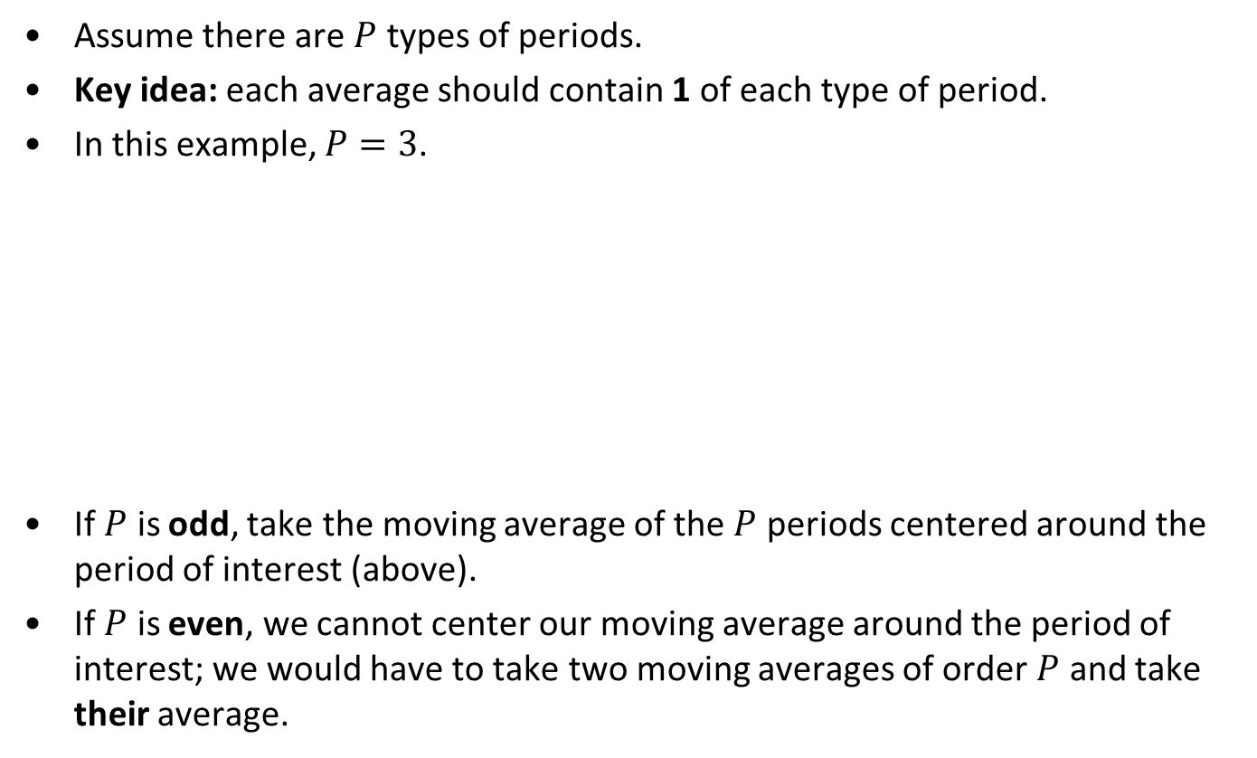
Step 1: Deseasonalize the demand data
Example 1
Assume there are $P$ types of periods.
Key idea: each average should contain 1 of each type of period.
In this example, $P=3$.
If $P$ is odd, take the moving average of the $P$ periods centered around the period of interest (above).
If $P$ is even, we cannot center our moving average around the period of interest; we would have to take two moving averages of order $P$ and take their average.
Year | Period | Time | Enrollment | Deseasonalized Demand
1 | Fall | 1 | 30
1 | Spring | 2 | 80 | 41.7
1 | Summer | 3 | 15 | 45.0
2 | Fall | 4 | 40 | 48.3
2 | Spring | 5 | 90 | 53.3
2 | Summer | 6 | 30

Slide 19
Step 2: Estimate the level and trend
Example 1
Recall that linear regression fits a line to data in the following format:
Dependent Variable
Independent Variable
=
Intercept
+
Slope
×
“Visually speaking:”
Slope
Intercept
Given several values of the independent variable and the corresponding values of the dependent variable, linear regression finds the value of intercept and slope that match the data best (for least-squares, by minimizing the squared error).

Slide 20

Step 2: Estimate the level and trend
Example 1
When we apply linear regression to deseasonalized demand data:
Demand = Intercept + Slope$×$ Time
We can use the Analysis Toolpak or the more powerful add-in StatTools to do linear regression.
Level
Trend
“Time” (Indep. Var.) | Deseasonalized demand (Dependent Var.)
2 | 41.7
3 | 45.0
4 | 48.3
5 | 53.5

Slide 21
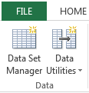
Step 2: Estimate the level and trend
Example 1
Use StatTools to define a data set.

Slide 22
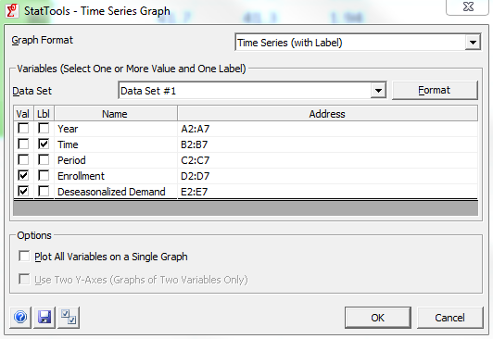
Step 2: Estimate the level and trend
Example 1
Before running ANY analysis, always plot the data!
Use the “Time Series Graph” function in StatTools.
Select (with label).
Plot both demand and deseasonalized demand with time as label.

Slide 23
Step 2: Estimate the level and trend
Example 1

Slide 24
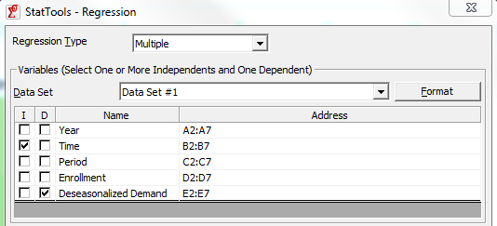
Step 2: Estimate the level and trend
Example 1
Run a regression with time as the independent variable and deseasonalized demand as the dependent variable.
You must have a line to use linear regression. Do not run linear regression directly on data that has any clear seasonal pattern!

Slide 25
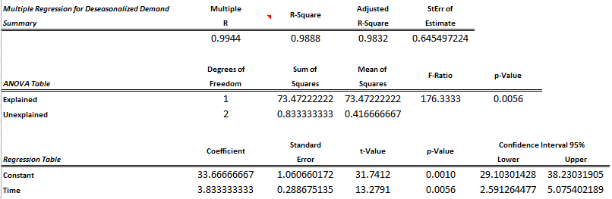
Step 2: Estimate the level and trend
Example 1
In the resulting report, we obtain two coefficients: constant and time.
The constant coefficient is the level at time 0.
The time coefficient is the trend.

Slide 26
Step 3: Estimate the seasonal factor
Example 1
Deseasonalized demand (Level) = 33.7 + 3.8 $×$ Time
Year | Period | “Time” | Enrollment | Deseasonalized Data | Level | Seasonal Factor Estimate
1 | Fall | 1 | 30 |  | 33.7+3.8*1 = 37.5 | 30/37.5 = 0.80
1 | Spring | 2 | 80 | 41.7 | 41.3 | 1.94
1 | Summer | 3 | 15 | 45.0 | 45.2 | 0.33
2 | Fall | 4 | 40 | 48.3 | 49.0 | 0.82
2 | Spring | 5 | 90 | 53.3 | 52.8 | 1.70
2 | Summer | 6 | 30 |  | 56.7 | 0.53
Average the seasonal factor estimates for each period:
Period | Seasonal Factor
Fall | 0.81
Spring | 1.82
Summer | 0.43

Slide 27
Forecasting the future demand
Example 1
Predict the demand for enrollments in Year 3 Fall.
This is time period 7
Fall seasonal factor is 0.81.
The predicted demand is 0.81 * ( 33.7 + 3.8 * 7 ) = 48.89
Deseasonalized demand (Level) = 33.7 + 3.8 $×$ Time
Period | Seasonal Factor
Fall | 0.81
Spring | 1.82
Summer | 0.43

Slide 28
Static Forecast
Example 2
The demand for XYZ’s product shows an annual pattern, where the demand grows from the first quarter to the next, then decreases in the third and fourth quarters. The demand data for the last two years is shown below.
Estimate the level, trend, and seasonal factors.
Year | Quarter | Demand
1 | 1 | 500
1 | 2 | 1000
1 | 3 | 400
1 | 4 | 300
2 | 1 | 600
2 | 2 | 1200
2 | 3 | 700
2 | 4 | 400

Slide 29

Estimating level, trend, and seasonal factors
Example 2
Notice that $P=4$, so deseasonalizing the demand is more complicated.
To calculate deseasonalized demand for time 3, we must use the demands from time 2, 3, 4, and the average of times 1 and 5.
In other words, times 1 and 5 each get ½ the weight of the others.
Year | Quarter | “Time” | Demand | Deseasonalized Demand
1 | 1 | 1 | 500
1 | 2 | 2 | 1000
1 | 3 | 3 | 400 | ????
1 | 4 | 4 | 300
2 | 1 | 5 | 600
2 | 2 | 6 | 1200
2 | 3 | 7 | 700
2 | 4 | 8 | 400

Slide 30


Estimating level, trend, and seasonal factors
Example 2
Steps 2 and 3 are similar to Example 1.
Year | Quarter | “Time” | Demand | Deseasonalized Demand
1 | 1 | 1 | 500
1 | 2 | 2 | 1000
1 | 3 | 3 | 400 | 562.5
1 | 4 | 4 | 300 | 600.0
2 | 1 | 5 | 600 | 662.5
2 | 2 | 6 | 1200 | 712.5
2 | 3 | 7 | 700
2 | 4 | 8 | 400
$$×1/2$$
$$×1/2$$

Slide 31
Linear Regression Diagnostics
Example 3
In our time-series analysis, X=time and Y=demand.
Constant: Y-value when X=0. In other words, this is the initial level of the demand.
Time Coefficient: Change in Y for every unit change in X. In other words, this is the trend of the demand.
R-squared: Tells how well the fitted line explains the change in Y.
R-squared = 0.60 means 60% of the change in Y (demand) is explained by change in X (time).
The rest is either explained by some other factor (such as…) or is unexplainable noise.
Every data set has noise.

Slide 32
Linear Regression Diagnostics
P-value: Tells us the significance of a coefficient.
Residual plot: shows the differences between the data and the predicted line.
No pattern: this is ideal, means the original data had a linear pattern.
Seasonal pattern in the residuals: this is bad, means the data was non-linear. If there is a pattern in the residuals, linear regression is NOT appropriate to use on the data set.
See Example 3. Linear Regression Diagnostics.

Slide 33
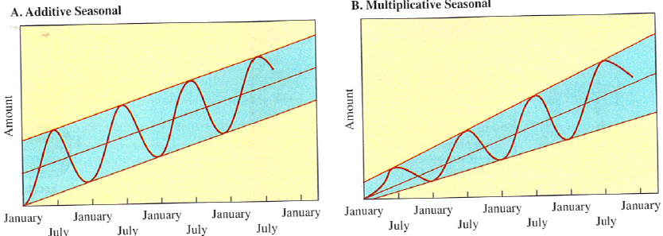
Types of Models: Mixed
Mixed: Demand = (Level + T x Trend) x Seasonal Factor
Trend is additive: add one more “Trend” every time period.
Seasonal factor is multiplicative: seasons result in a % increase/decrease in demand.

Slide 34
Types of Models: Additive
Additive: Demand = Level + T x Trend + Seasonal Factor
Trend is additive: add one more “Trend” every time period.
Seasonal factor is additive: seasons result in a fixed increase/decrease in demand, regardless of underlying demand.

Slide 35
Types of Models: Additive
Additive: Demand = Level + T x Trend + Seasonal Factor
Trend is additive: add one more “Trend” every time period.
Seasonal factor is additive: seasons result in a fixed increase/decrease in demand, regardless of underlying demand.
Modify calculation of seasonal factor
When seasonal factor is multiplicative, estimate by SF = demand / level
When seasonal factor is additive, estimate by SF = demand – level

Slide 36
Types of Models: Multiplicative
Multiplicative: Demand = Level x Trend^{T} x Seasonal Factor
Trend is multiplicative: demand increases by same % each period.
Seasonal factor is multiplicative: seasons result in a % increase/decrease in demand.
Also called exponential growth.

Slide 37
Types of Models: Multiplicative
Multiplicative: Demand = Level x Trend^{T} x Seasonal Factor
We handle this model by taking the log of both sides:
Log( Demand ) = Log( Level x Trend^{T} x Seasonal Factor )
Use the rules Log( a x b ) = Log( a ) + Log( b ) and Log( a^{b} ) = b x Log( a )
Log( Demand ) = Log( Level ) + T x Log( Trend ) + Log( Seasonal Factor )
Thus, we use a log transform of the data and then handle the data as if it is an additive model!

Slide 38
Types of Models: Multiplicative
Example 4
Let’s examine sales of a new technology product.
Remember, graph the data first.
Week | Cumulative Sales ($) | Weekly Sales
1 | $ 1,059,204.63 | $ 1,059,204.63
2 | $ 1,874,630.54 | $ 815,425.91
3 | $ 2,552,518.85 | $ 677,888.31
4 | $ 3,139,080.54 | $ 586,561.69
5 | $ 3,631,538.93 | $ 492,458.39
6 | $ 3,987,823.02 | $ 356,284.09
7 | $ 4,319,397.99 | $ 331,574.97
8 | $ 4,609,827.33 | $ 290,429.34

Slide 39
Types of Models: Multiplicative
Log

Slide 40
Types of Models: Multiplicative
Example 4
Log transform can be accomplished with the =LN function.
Once we are done, we can recover our coefficients with the =EXP function (exponential, the inverse of log).
How to tell if we need to use a multiplicative model? Examine the plot of data and the residual plot.

